Slide 1
ADWG
Maciej Zelwak
Notes:
Glossary:
AGGREGATE
A cluster of associated objects that are treated as a unit for the purpose of data changes.
External references are restricted to one member of the AGGREGATE, designated as the root.
A set of consistency rules applies within the AGGREGATE'S boundaries.
analysis pattern
A group of concepts that represents a common construction in business modeling. It may be
relevant to only one domain or may span many domains (Fowler 1997, p. 8).
ASSERTION
A statement of the correct state of a program at some point, independent of how it does it.
Typically, an ASSERTION specifies the result of an operation or an invariant of a design
element.
BOUNDED CONTEXT
The delimited applicability of a particular model. BOUNDING CONTEXTS gives team members a
clear and shared understanding of what has to be consistent and what can develop
independently.
client
A program element that is calling the element under design, using its capabilities.
cohesion
Logical agreement and dependence.
command (a.k.a. modifier)
An operation that effects some change to the system (for example, setting a variable). An
operation that intentionally creates a side effect.
CONCEPTUAL CONTOUR
An underlying consistency of the domain itself, which, if reflected in a model, can help the
design accommodate change more naturally.
context
The setting in which a word or statement appears that determines its meaning.
See also [BOUNDED CONTEXT]
CONTEXT MAP
A representation of the BOUNDED CONTEXTS involved in a project and the actual relationships
between them and their models.
CORE DOMAIN
The distinctive part of the model, central to the user's goals, that differentiates the
application and makes it valuable.
declarative design
A form of programming in which a precise description of properties actually controls the
software. An executable specification.
deep model
An incisive expression of the primary concerns of the domain experts and their most
relevant knowledge. A deep model sloughs off superficial aspects of the domain and naive
interpretations.
design pattern
A description of communicating objects and classes that are customized to solve a general
design problem in a particular context. (Gamma et al. 1995, p. 3)
distillation
A process of separating the components of a mixture to extract the essence in a form that
makes it more valuable and useful. In software design, the abstraction of key aspects in a
model, or the partitioning of a larger system to bring the CORE DOMAIN to the fore.
domain
A sphere of knowledge, influence, or activity.
domain expert
A member of a software project whose field is the domain of the application, rather than
software development. Not just any user of the software, the domain expert has deep
knowledge of the subject.
domain layer
That portion of the design and implementation responsible for domain logic within a LAYERED
ARCHITECTURE. The domain layer is where the software expression of the domain model lives.
ENTITY
An object fundamentally defined not by its attributes, but by a thread of continuity and
identity.
FACTORY
A mechanism for encapsulating complex creation logic and abstracting the type of a created
object for the sake of a client.
function
An operation that computes and returns a result without observable side effects.
immutable
The property of never changing observable state after creation.
implicit concept
A concept that is necessary to understand the meaning of a model or design but is never
mentioned.
INTENTION-REVEALING INTERFACE
A design in which the names of classes, methods, and other elements convey both the
original developer's purpose in creating them and their value to a client developer.
invariant
An ASSERTION about some design element that must be true at all times, except during
specifically transient situations such as the middle of the execution of a method, or the
middle of an uncommitted database transaction.
iteration
A process in which a program is repeatedly improved in small steps. Also, one of those
steps.
large-scale structure
A set of high-level concepts, rules, or both that establishes a pattern of design for an entire
system. A language that allows the system to be discussed and understood in broad strokes.
LAYERED ARCHITECTURE
A technique for separating the concerns of a software system, isolating a domain layer,
among other things.
life cycle
A sequence of states an object can take on between creation and deletion, typically with
constraints to ensure integrity when changing from one state to another. May include
migration of an ENTITY between systems and different BOUNDED CONTEXTS.
model
A system of abstractions that describes selected aspects of a domain and can be used to
solve problems related to that domain.
MODEL-DRIVEN DESIGN
A design in which some subset of software elements corresponds closely to elements of a
model. Also, a process of codeveloping a model and an implementation that stay aligned
with each other.
modeling paradigm
A particular style of carving out concepts in a domain, combined with tools to create
software analogs of those concepts (for example, object-oriented programming and logic
programming).
REPOSITORY
A mechanism for encapsulating storage, retrieval, and search behavior which emulates a
collection of objects.
responsibility
An obligation to perform a task or know information (Wirfs-Brock et al. 2003, p. 3).
SERVICE
An operation offered as an interface that stands alone in the model, with no encapsulated
state.
side effect
Any observable change of state resulting from an operation, whether intentional or not, even
a deliberate update.
SIDE-EFFECT-FREE FUNCTION
See [function]
STANDALONE CLASS
A class that can be understood and tested without reference to any others, except system
primitives and basic libraries.
stateless
The property of a design element that allows a client to use any of its operations without
regard to the element's history. A stateless element may use information that is accessible
globally and may even change that global information (that is, it may have side effects) but
holds no private state that affects its behavior.
strategic design
Modeling and design decisions that apply to large parts of the system. Such decisions affect
the entire project and have to be decided at team level.
supple design
A design that puts the power inherent in a deep model into the hands of a client developer
to make clear, flexible expressions that give expected results robustly. Equally important, it
leverages that same deep model to make the design itself easy for the implementer to mold
and reshape to accommodate new insight.
UBIQUITOUS LANGUAGE
A language structured around the domain model and used by all team members to connect
all the activities of the team with the software.
unification
The internal consistency of a model such that each term is unam-biguous and no rules
contradict.
VALUE OBJECT
An object that describes some characteristic or attribute but carries no concept of identity.
WHOLE VALUE
An object that models a single, complete concept.
Core definitions
Domain: A sphere of knowledge (ontology), influence, or activity. The subject area to which the user applies a program is the domain of the software.
Model: A system of abstractions that describes selected aspects of a domain and can be used to solve problems related to that domain.
Ubiquitous Language: A language structured around the domain model and used by all team members to connect all the activities of the team with the software.
Context: The setting in which a word or statement appears that determines its meaning.
Prerequisites for the successful application of DDD
Your domain is not trivial
The project team has experience and interest in Object Oriented Programming/Design
You have access to domain experts
You have an iterative process
Building blocks
Strategic patterns
Domain, and Subdomains: As mentioned above, a Domain is a sphere of knowledge. A Domain can be split into Subdomains if it is too large. The Domain is usually known as the problem space.
Bounded Context: A Bounded context should be aligned with a Domain or a Subdomain. There is one Ubiquitous Language applied within a Bounded Context. A Bounded Context is usually the solution space, where we design our software or business solution.
Context Map: A Context Map displays the alignment of Domains, Subdomains and their Bounded Contexts. A Context Map also shows dependencies between Bounded Contexts. Such dependencies can be upstream or downstream. Dependencies show where integration patterns should or must be applied.
Tactical patterns
Entity: An object that is not defined by its attributes, but rather by a thread of continuity and its identity. Example: Most airlines distinguish each seat uniquely on every flight. Each seat is an entity in this context. However, Southwest Airlines (or EasyJet/RyanAir for Europeans) does not distinguish between every seat; all seats are the same. In this context, a seat is actually a value object. Value Object: An object that contains attributes but has no conceptual identity. They should be treated as immutable. Example: When people exchange dollar bills, they generally do not distinguish between each unique bill; they only are concerned about the face value of the dollar bill. In this context, dollar bills are value objects. However, the Federal Reserve may be concerned about each unique bill; in this context each bill would be an entity. Aggregate: A collection of objects that are bound together by a root entity, otherwise known as an aggregate root. The aggregate root guarantees the consistency of changes being made within the aggregate by forbidding external objects from holding references to its members. Aggregates can also be seen as a kind of bounded context, giving the root entity and the whole object graph a context in which they are used. Example: When you drive a car, you do not have to worry about moving the wheels forward, making the engine combust with spark and fuel, etc.; you are simply driving the car. In this context, the car is an aggregate of several other objects and serves as the aggregate root to all of the other systems. A steering wheel can be rotated, this is it's context within the car aggregate. It can also be produced or recycled. This usually happens not within the driving car context, so this would be another aggregate, probably referencing the car as well.
Domain Events: Domain events can be used to model distributed systems. The model will become more complex, but it can by more scalable. Domain Events are often used in an Event Driven Architecture
Service: When an operation does not conceptually belong to any object. Following the natural contours of the problem, you can implement these operations in services. Repository: Repositories save and retrieve Entities or Aggregates to or from the underlying storage mechanism. Repositories are part of the domain model, so they should be database vendor independent. Repositories can use DAO's(Data Access Objects) for retrieving data and to encapsulate database specific logic from the domain. Note: Hibernate is also a Data Access Object! Wrapping Hibernate inside a DAO can be an overkill. Repositories can use an Aggregate Oriented Database.
Modules, also known as Packages: Components with high cohesion should be packaged together. Modules are defined by business dependencies, not by the technical architecture.
Example: The Bill Aggregate and the Bill Repository should be put into the same module, as they are very tightly coupled. Factory: methods for creating domain objects should delegate to a specialized Factory object such that alternative implementations may be easily interchanged.

Slide 2
Agenda
1. AOB (Actions)
2. Understanding Quality Attributes
3. Availability
4. Interoperability

Slide 3
Quality attribute
A quality attribute (QA) is a measurable or testable property of a system that is used to indicate how well the system satisfies the needs of its stakeholders.
Examples:
- how fast the function must be performed
- how resilient it must be to erroneous input
- time to deploy the product
- limitation on operational costs

Slide 4
Understanding Quality Attributes Architecture and Requirements
Assigning responsibilities to architectural elements
Functional requirements
Various structures designed into the architecture
Quality attribute requirements
Accepting the design decision
Constraints

Slide 5
Understanding Quality Attributes Functionality
The ability of the system to do the work for which it was intended.
functionality does not determine architecture, but is achieved by assigning responsibilities to architectural elements.

Slide 6
Understanding Quality Attributes Quality Attribute Considerations
Quality Attributes
Availability, Performance, Usability
RUNTIME
Modifiability, Testability
DEVELOPMENT
Problems:
The definitions provided for an attribute are not testable
Matching particular concerns to qualities
Different vacabularies developed by each attribute community

Slide 7
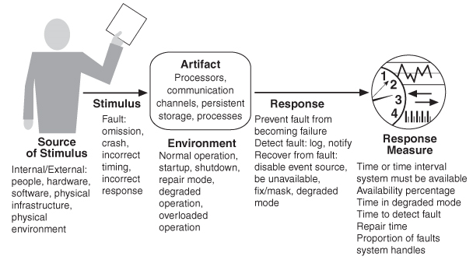
Understanding Quality Attributes Specifying Quality Attribute Requirements
Common (general) form for quality attribute expression contains 6 steps.
Example
for
availability:

Slide 8
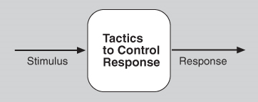
Understanding Quality Attributes Achieving Quality Attributes through Tactics
Tactics are intended to control responses to stimuli
Why we need tactics:
1. Design patterns are typically
to complex to apply as is.
2. If no pattern to realize goal, tactics allow
to construct a design fragment.
3. Cataloging tactics provides a way of making
design more systematic withn some limitations.
Application of a tactic depends on the context!
Architectural patterns can be seen as “packages” of tactics.

Slide 9
Understanding Quality Attributes Guiding Quality Design Decisions
1. Allocation of responsibilities
Identifying the important responsibilities and Determining how these responsibilities are allocated to non-runtime and runtime elements
2. Coordination model
Software works by having elements interact with each other through designed mechanisms. Identification of elements that must be coordinated, determining the properties of coordination and Choosing the communication mechanisms
3. Data model
Choosing the major data abstractions, This includes determining how the data items are created, initialized, accessed, persisted, manipulated, translated, and destroyed. Organizing the data. This includes determining whether the data is going to be kept in a relational database, a collection of objects, or both.
4. Management of resources
use of shared resources in the architecture. These include hard resources (e.g., CPU, memory, battery, hardware buffers, system clock, I/O ports) and soft resources (e.g., system locks, software buffers, thread pools, and non-thread-safe code).
5. Mapping among architectural elements
Mapping between elements in different types of architecture structures—for example, mapping from units of development (modules) to units of execution (threads or processes).
Mapping between software elements and environment elements—for example, mapping from processes to the specific CPUs where these processes will execute.
6. Binding time decisions
Binding time decisions introduce allowable ranges of variation. When making binding time decisions, you should consider the costs to implement the decision and the costs to make a modification after you have implemented the decision.
7. Choice of technology
Every architecture decision must eventually be realized using a specific technology. Deciding which technologies are available, available tools to support technology choice, external support available for the technology, Determining the side effects of choosing a technology, Determining whether a new technology is compatible with the existing technology stack

Slide 10
Understanding Quality Attributes Discussion questions
1. What is the relationship between a use case and a quality attribute scenario? If you wanted to add quality attribute information to a use case, how would you do it?
2. Do you suppose that the set of tactics for a quality attribute is finite or infinite? Why?
3. Discuss the choice of programming language (an example of choice of technology) and its relation to architecture in general, and the design decisions in the other six categories? For instance, how can certain programming languages enable or inhibit the choice of particular coordination models?
4. We will be using the automatic teller machine as an example throughout the chapters on quality attributes. Enumerate the set of responsibilities that an automatic teller machine should support and propose an initial design to accommodate that set of responsibilities. Justify your proposal.
5. Think about the screens that your favorite automatic teller machine uses. What do those screens tell you about binding time decisions reflected in the architecture?
6. Consider the choice between synchronous and asynchronous communication (a choice in the coordination mechanism category). What quality attribute requirements might lead you to choose one over the other?
7. Consider the choice between stateful and stateless communication (a choice in the coordination mechanism category). What quality attribute requirements might lead you to choose one over the other?
8. Most peer-to-peer architecture employs late binding of the topology. What quality attributes does this promote or inhibit?

Slide 11
Availability Definition
Def
Dependability - ability to avoid failures that are more frequent and more severe than is acceptable.
Availability = reliability + recovery
Availability refers to the ability of a system to mask or repair faults such that the cumulative service outage period does not exceed a required value over a specified time interval. In other words availability is about minimizing service outage time by mitigating faults.
Availability is closely related to:
- security
- performance
- safety

Slide 12
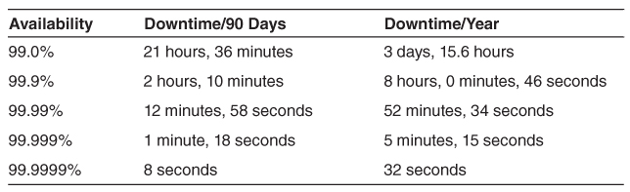
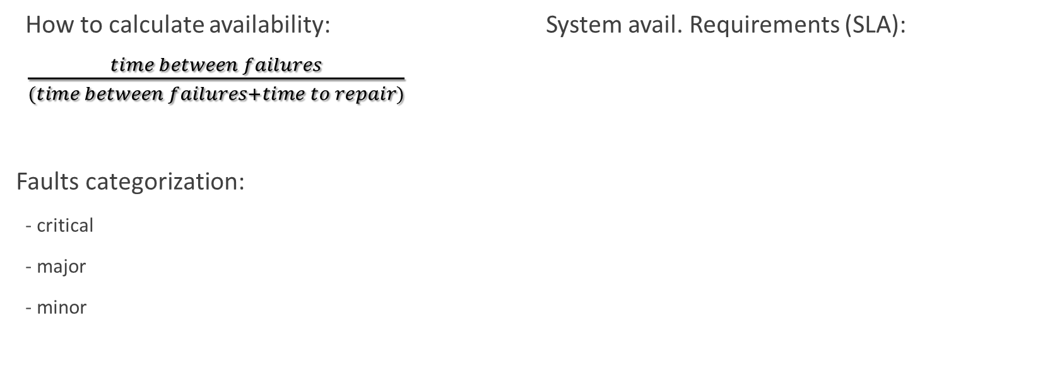
Availability Faults
A failure’s cause is called a fault. A fault can be either internal or external. Intermediate states between the occurrence of a fault and failure are called errors.
How to calculate availability:
$\frac{time between failures}{(time between failures+time to repair)}$
Faults categorization:
- critical
- major
- minor
System avail. Requirements (SLA):

Slide 13
Availability Faults
A failure’s cause is called a fault. A fault can be either internal or external. Intermediate states between the occurrence of a fault and failure are called errors.
How to calculate availability:
$\frac{time between failures}{(time between failures+time to repair)}$
Faults categorization:
- critical
- major
- minor
System avail. Requirements (SLA):

Slide 14
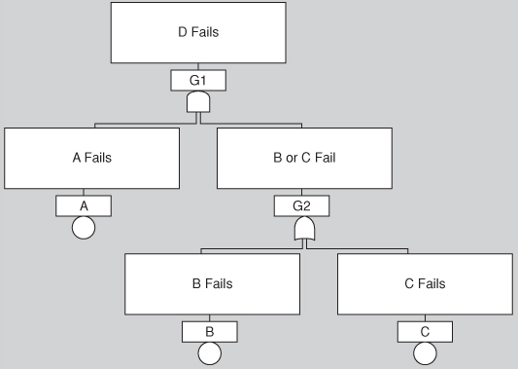
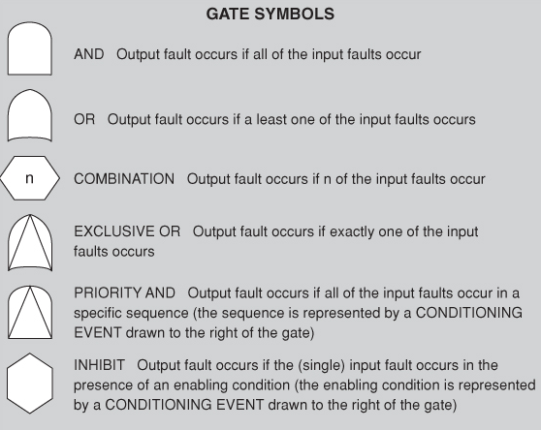
Availability Planning for Failure
Hazard analysis
Fault tree analysis
Hazard analysis is a technique that attempts to catalog the hazards that can occur during the operation of a system.
Ex:
Catastrophic
Hazardous
Major
Minor
No effect
Fault tree analysis is an analytical technique that specifies a state of the system that negatively impacts safety or reliability, and then analyzes the system’s context and operation to find all the ways that the undesired state could occur.

Slide 15
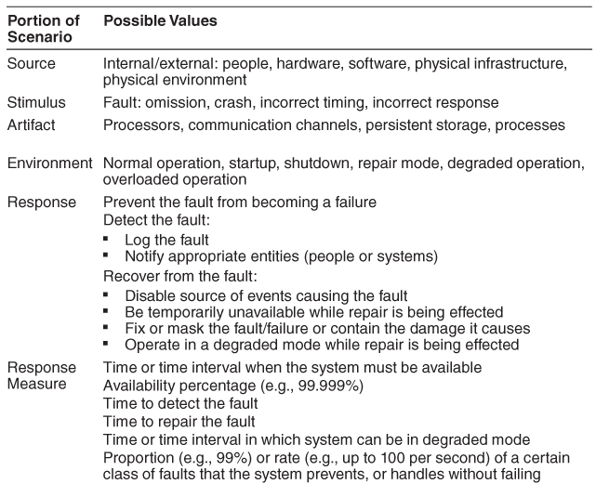
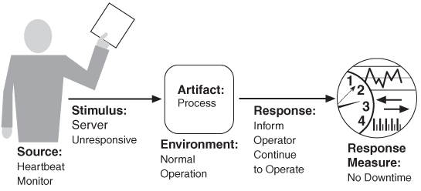
Availability Availability General Scenario

Slide 16
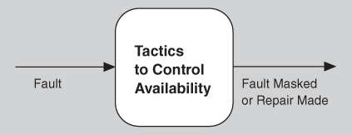
Availability Tactics for Availability
Availability tactics
Detect faults
Recover from faults
Prevent faults

Slide 17
Availability Tactics for Availability: Detect faults
Tactics | Description
Ping/echo | Asynchronous request/response message pair exchanged between nodes. Determines reachability and the round-trip delay through the associated network path.
Monitor | Used to monitor the state of health of various other parts of the system: processors, processes, I/O, memory, and so on.
Heartbeat | Fault detection mechanism that employs a periodic message exchange between a system monitor and a process being monitored
Time stamp | Used to detect incorrect sequences of events, primarily in distributed message-passing systems.
Sanity checking | Checks the validity or reasonableness of specific operations or outputs of a component.

Slide 18
Availability Tactics for Availability: Detect faults
Tactics | Description
Condition monitoring | Checking conditions in a process or device, or validating assumptions made during the design.
Voting (replication, functional redundancy, analytic redundancy) | Typically three components that do the same thing, each of which receives identical inputs, and forwards their output to voting logic, used to detect any inconsistency among the three output states.
Exception (system exceptions, parameter fence, parameter typing, timeout) | Refers to the detection of a system condition that alters the normal flow of execution.
Self-test | Components can run procedures to test themselves for correct operation. Self-test procedures can be initiated by the component itself, or invoked from time to time by a system monitor.

Slide 19
Availability Tactics for Availability: Recover from faults, Preparation and repair
Tactics | Description
Active redundancy | This refers to a configuration where all of the nodes (active or redundant spare) in a protection group2 receive and process identical inputs in parallel, allowing the redundant spare(s) to maintain synchronous state with the active node(s).
Passive redundancy | This refers to a configuration where only the active members of the protection group process input traffic; one of their duties is to provide the redundant spare(s) with periodic state updates.
Spare | Cold sparing refers to a configuration where the redundant spares of a protection group remain out of service until a fail-over occurs, at which point a power-on-reset procedure is initiated on the redundant spare prior to its being placed in service.
Exception handling | Once an exception has been detected, the system must handle it in some fashion. The easiest thing it can do is simply to crash, but of course that’s a terrible idea from the point of availability, usability, testability, and plain good sense.
Rollback | This tactic permits the system to revert to a previous known good state, referred to as the “rollback line”—rolling back time—upon the detection of a failure. Once the good state is reached, then execution can continue.

Slide 20
Availability Tactics for Availability: Recover from faults, Preparation and repair
Tactics | Description
Software upgrade | Preparation-and-repair tactic whose goal is to achieve in-service upgrades to executable code images in a non-service-affecting manner.
Retry | The retry tactic assumes that the fault that caused a failure is transient and retrying the operation may lead to success.
Ignore faulty behaviour | This tactic calls for ignoring messages sent from a particular source when we determine that those messages are spurious.
Ignore faulty behaviour | Tactic maintains the most critical system functions in the presence of component failures, dropping less critical functions.
Reconfiguration | Recover from component failures by reassigning responsibilities to the (potentially restricted) resources left functioning.

Slide 21
Availability Tactics for Availability: Recover from faults, Reintroduction
Tactics | Description
Shadow | Tactic refers to operating a previously failed or in-service upgraded component in a “shadow mode” for a predefined duration of time prior to reverting the component back to an active role.
State resynchronization | This is a reintroduction partner to the active redundancy and passive redundancy preparation-and-repair tactics.
Escalating restart | This is a reintroduction tactic that allows the system to recover from faults by varying the granularity of the component(s) restarted and minimizing the level of service affected.
Non-stop forwarding | This is a concept that originated in router design. In this design functionality is split into two parts: supervisory, or control plane (which manages connectivity and routing information), and data plane (which does the actual work of routing packets from sender to receiver).

Slide 22
Availability Tactics for Availability: Prevent faults
Tactics | Description
Removal from service | This tactic refers to temporarily placing a system component in an out-of-service state for the purpose of mitigating potential system failures.
Transactions | Systems targeting high-availability services leverage transactional semantics to ensure that asynchronous messages exchanged between distributed components are atomic, consistent, isolated, and durable. These four properties are called the “ACID properties.”
Predictive model | A predictive model, when combined with a monitor, is employed to monitor the state of health of a system process to ensure that the system is operating within its nominal operating parameters, and to take corrective action when conditions are detected that are predictive of likely future faults.
Exception prevention | This tactic refers to techniques employed for the purpose of preventing system exceptions from occurring.
Increase competence set | A program’s competence set is the set of states in which it is “competent” to operate.

Slide 23
Availability A Design Checklist for Availability
Category | Checklist
Allocation of responsibilities | Determine responsibilities that need to be highly available. Ensure that responsibilities to detect crash, incorrect timing or response, log fault, notificatotion, disabling source of fault, fixing fault, etc. Have been allocated.
Coordination model | Ensure that coordination mechanisms can detect an omission, crash, etc. Coordination model supports the replacement of the artifacts used (processors, communication channels, etc.). Make sure that coordination will work under conditions of degraded communication.
Data model | Detemine which parts of the system must bu highly available. Within this portions identify parts that could cause fault, crash, etc. Ensure that this parts can be disabled or temporary unavailable or be fixed in the event of fault.

Slide 24
Availability A Design Checklist for Availability
Category | Checklist
Mapping among architectural elements | Determine which artifacts may produce fault. For instance which processes on failed processors need to be reasigned at runtime. How quickly system can be reinstalled.
Resource Management | Determine what critical resources are necessary to continue operating in the presence of a fault. The availability time for critical resources.
Binding time | Determine how and when architectural elements are bound. Consider late binding scenerious.
Choice of technology | Consider technologies that can help detect faults and recover from faults. (ex. Event loggers).

Slide 25
Interoperability Definition
Interoperability is about the degree to which two or more systems can usefully exchange meaningful information via interfaces in a particular context. The definition includes not only having the ability to exchange data (syntactic interoperability) but also having the ability to correctly interpret the data being exchanged (semantic interoperability).
Systems of Systems
Acknowledged
Collaborative
Directed
Virtual
Two important aspects of interoperability:
- Discovery (The consumer of a service must discover the location, identity, and the interface of the service.)
- Handling of the response (report back to requestor, report to another system, broadcast to all listeneres)

Slide 26
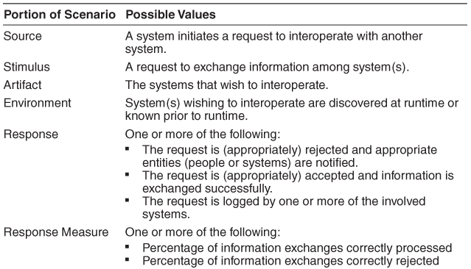
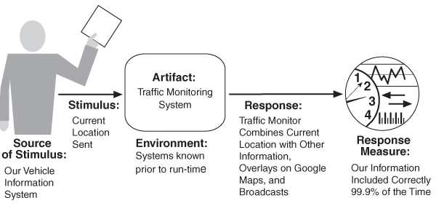
Interoperability Interoperability General Scenario

Slide 27
Interoperability Interoperability General Scenario: Interaction protocols
SOAP is a protocol specification for XML-based information that distributed applications can use to exchange information and hence interoperate. It is most often accompanied by a set of SOA middleware interoperability standards and compliant implementations.
REST is a client-server-based architectural style that is structured around a small set of create, read, update, delete (CRUD) operations (called POST, GET, PUT, DELETE respectively in the REST world) and a single addressing scheme (based on a URI, or uniform resource identifier).
RMI ...
 | SOAP | REST
Simplicity |  | ●
Completeness | ●
Standarized | ●
Stateless |  | ●
Security | ●

Slide 28
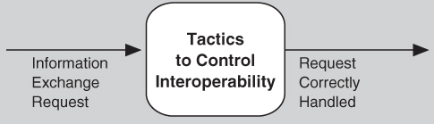
Interoperability Tactics for Interoperability
Locate
Discover service - Locate a service through searching a known directory service.
II. Manage Interfaces
1. Orchestrate - Orchestrate is a tactic that uses a control mechanism to coordinate and manage and sequence the invocation of particular services (which could be ignorant of each other). Ex: workflows
2. Tailor interface - Tailor interface is a tactic that adds or removes capabilities to an interface. Capabilities such as translation, adding buffering, or smoothing data can be added. Capabilities may be removed as well. Ex: decorator pattern

Slide 29
Interoperability Tactics for Interoperability: Why standards are not enough?
We cannot let standards drive our architectures. We need to architect systems first and then decide which standards can support desired system requirements and qualities. This approach allows standards to change and evolve without affecting the overall architecture of the system.
Why?
1. Standards, when incorporated into products, tools, and services, undergo customizations and extensions.
2. Standards, like any technology, have a life cycle of their own and evolve over time in compatible and noncompatible ways.
3. Within the software community, there are as many bad standards as there are engineers with opinions.
4. It is quite common for standards to be championed by competing organizations, resulting in conflicting standards due to overlap or mutual exclusion.
5. For new and rapidly emerging domains, the argument often made is that standardization will be destructive because it will hinder flexibility.

Slide 30
Interoperability A Design Checklist for Interoperability
Category | Checklist
Allocation of responsibilities | Responsibilities in the system that need to interoperate with other systems Responsibilities that detect a request to interoperate with other systems allocated Responsibilites for below tasts allocated: accept, exchange, reject, notify entities, log the request
Coordination model | Consider quality attribure requirements and performance issues: Volume of traffic on the network Timeliness of the messages Jitter of the messages’ Define protocols and underlying networks
Data model | Define the syntax and semantics Make sure data model is consistent with data from other systems (you may have to apply transformations)

Slide 31
Interoperability A Design Checklist for Interoperability
Category | Checklist
Mapping among architectural elements | Critical mapping components to processors Security, availability and performance
Resource Management | Requests’ acceptance and rejection cannot exhaust critical system resources Resource load imposed by interoperation is considered and acceptable All policies are in place for shared resources
Binding time | Make sure that: System has policy for dealing with binding Rejecting mechanism is in place and requests are logged For late binding, support for discorey and sending information
Choice of technology | All technologies visible at the intefrace boundary must have identified effect on the interoperability. Consider technologies supporting interoperability (eg. web services)

Slide 32
Interoperability Discussion Questions
1. Find a web service mashup. Write several concrete interoperability scenarios for this system.
2. What is the relationship between interoperability and the other quality attributes highlighted in this book? For example, if two systems fail to exchange information properly, could a security flaw result? What other quality attributes seem strongly related (at least potentially) to interoperability?
3. Is a service-oriented system a system of systems? If so, describe a service-oriented system that is directed, one that is acknowledged, one that is collaborative, and one that is virtual.
4. Universal Description, Discovery, and Integration (UDDI) was touted as a discovery service, but commercial support for UDDI is being withdrawn. Why do you suppose this is? Does it have anything to do with the quality attributes delivered or not delivered by UDDI solutions?
5. Why has the importance of orchestration grown in recent years?
6. If you are a technology producer, what are the advantages and disadvantages of adhering to interoperability standards? Why would a producer not adhere to a standard?
7. With what other systems will an automatic teller machine need to interoperate? How would you change your automatic teller system design to accommodate these other systems?

